Slide 1

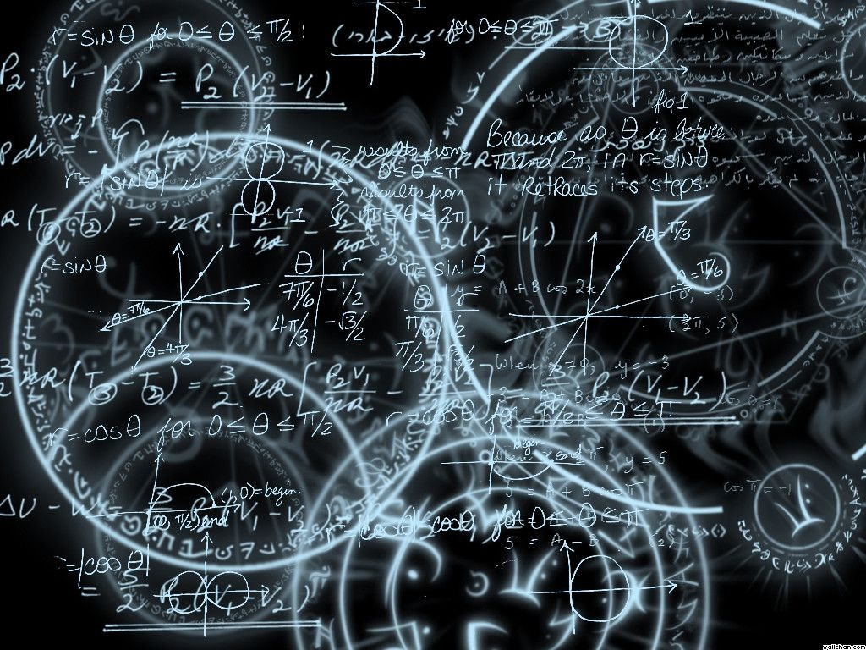
Azərbaycan Dövlət Neft və Sənaye Universiteti
Calculus
Single Variable

Slide 2
Integration by Substitution

Slide 3
In this lecture you will study techniques for integrating composite functions.
The discussion is split into two parts:
pattern recognition;
change of variables.

Slide 4
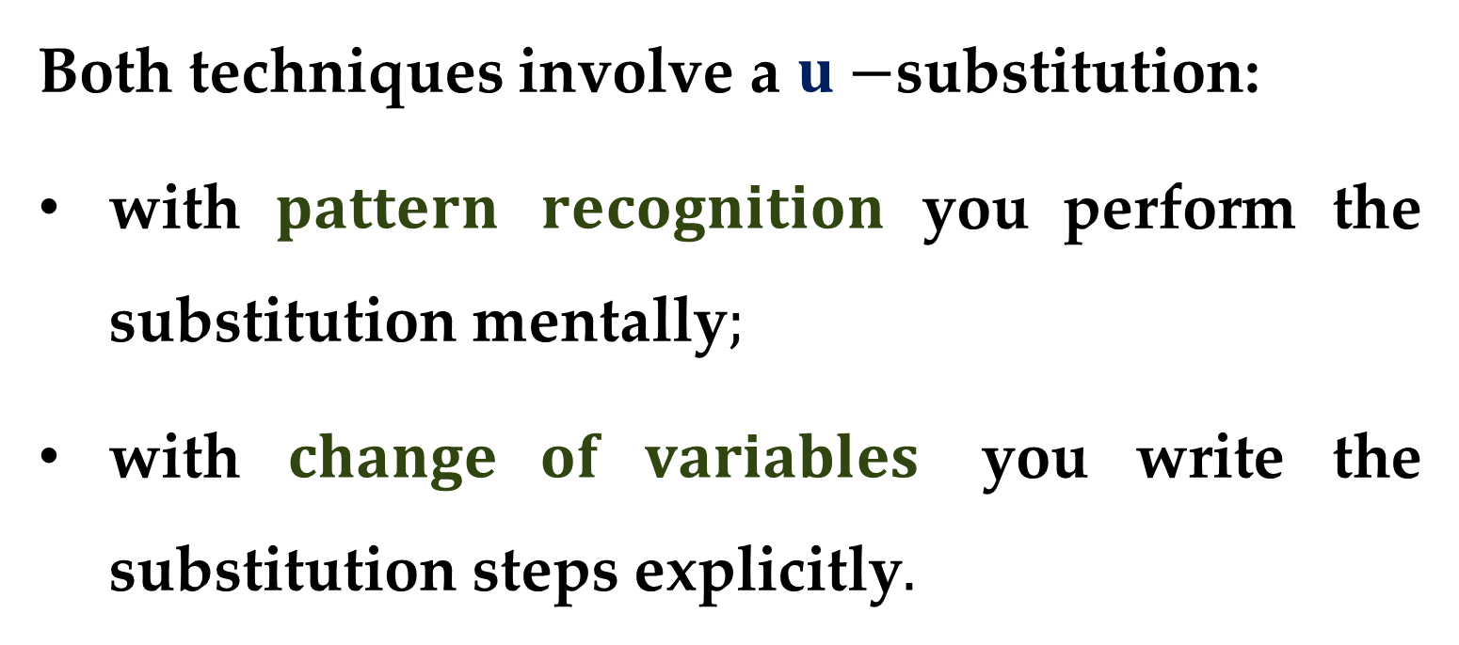
Both techniques involve a $u−$substitution:
with $pattern recognition$ you perform the substitution mentally$;$
with $change of variables$ you write the substitution steps explicitly$.$

Slide 5
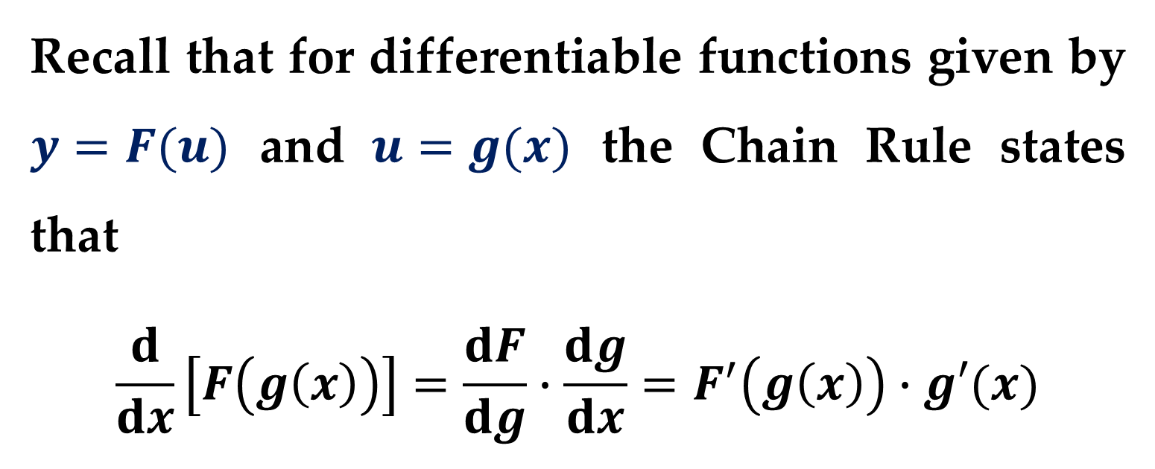
The role of substitution in integration is comparable to the role of the Chain Rule in differentiation.
Recall that for differentiable functions given by $y=F(u)$ and $u=g(x)$ the Chain Rule states that
$$\frac{d}{dx}\left[F\left(g\left(x\right)\right)\right]=\frac{dF}{dg}∙\frac{dg}{dx}=F^{′}\left(g\left(x\right)\right)∙g′(x)$$

Slide 6
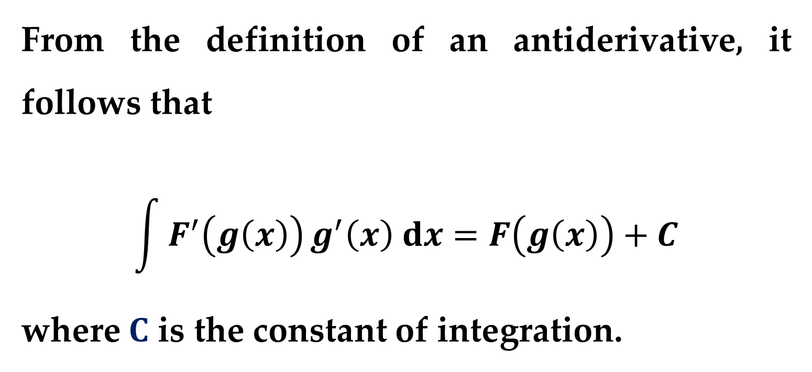
From the definition of an antiderivative, it follows that
$$\int{F^{′}\left(g\left(x\right)\right)}g^{′}\left(x\right) dx=F\left(g\left(x\right)\right)+C$$
where $C$ is the constant of integration.

Slide 7
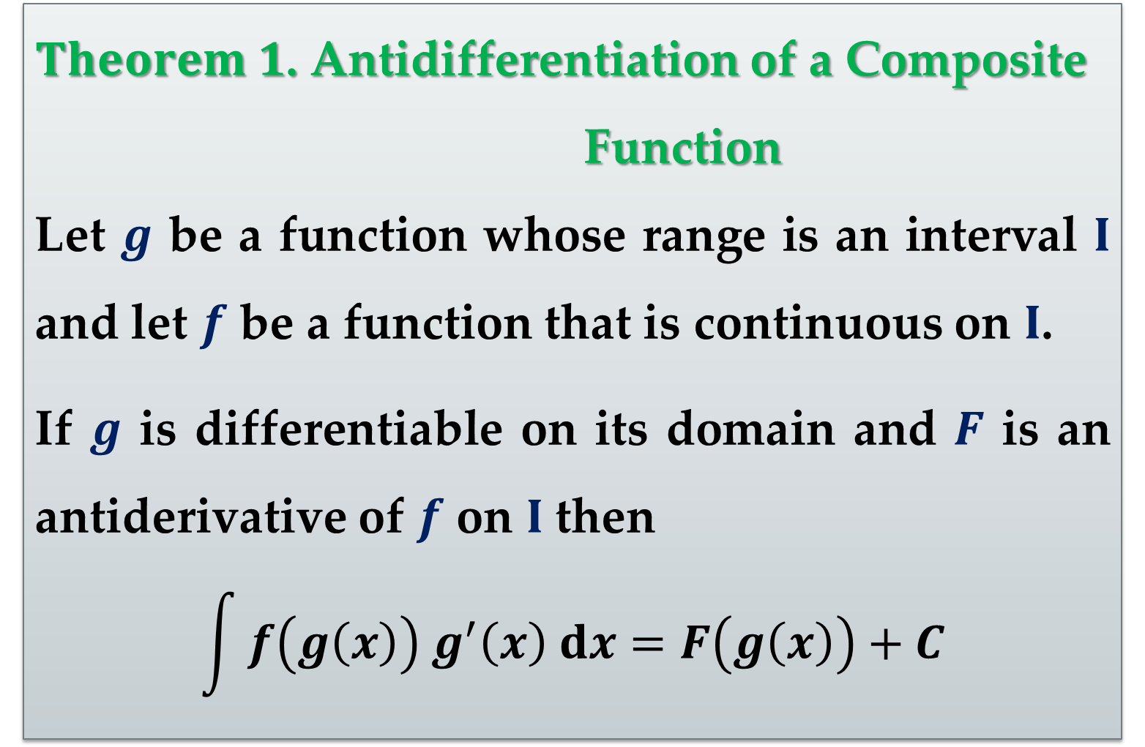
$Theorem 1$. Antidifferentiation of a Composite
Function
Let $g$ be a function whose range is an interval $I$ and let $f$ be a function that is continuous on $I$.
If $g$ is differentiable on its domain and $F$ is an antiderivative of $f$ on $I$ then
$$\int{f\left(g\left(x\right)\right) g^{′}\left(x\right) dx}=F\left(g\left(x\right)\right)+C$$

Slide 8
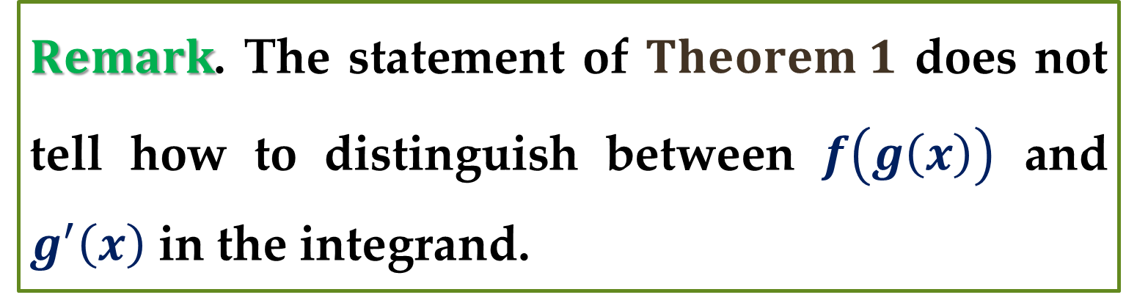
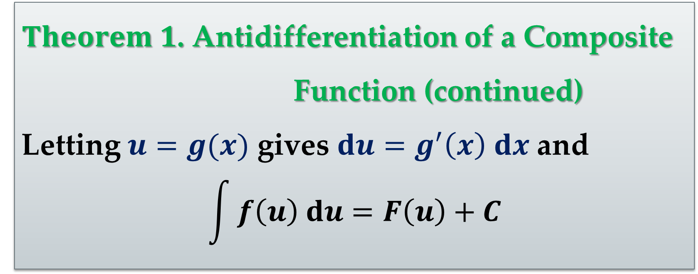
$Theorem 1$. Antidifferentiation of a Composite
Function (continued)
Letting $u=g(x)$ gives $du=g^{′}\left(x\right) dx$ and
$$\int{f\left(u\right) du}=F\left(u\right)+C$$
$Remark$. The statement of $Theorem 1$ does not tell how to distinguish between $f\left(g\left(x\right)\right)$ and $g^{′}\left(x\right)$ in the integrand.

Slide 9
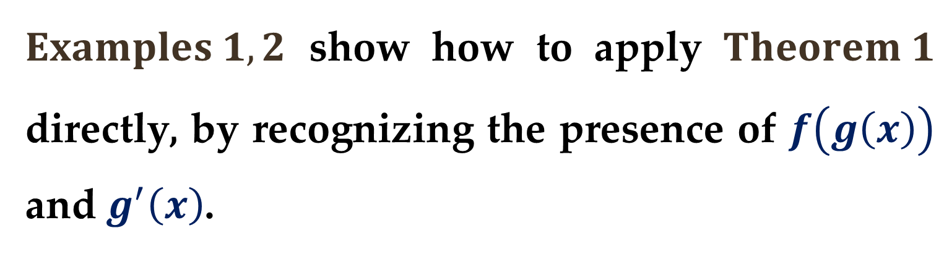
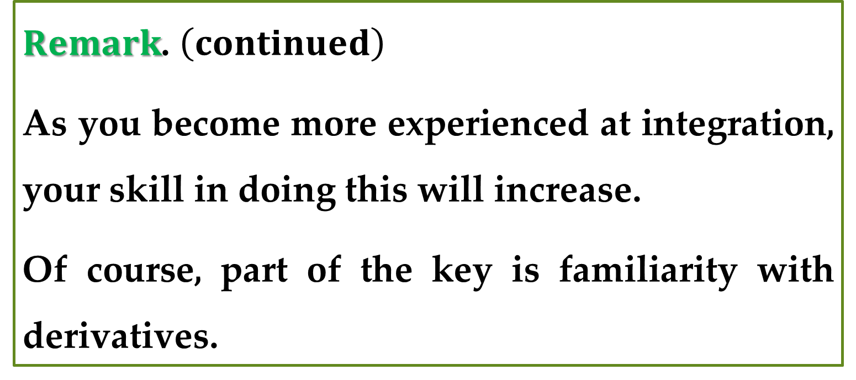
$Remark$. $\left(continued\right)$
As you become more experienced at integration, your skill in doing this will increase.
Of course, part of the key is familiarity with derivatives.
$Examples 1,2$ show how to apply $Theorem 1$ directly, by recognizing the presence of $f\left(g\left(x\right)\right)$ and $g^{′}\left(x\right)$.

Slide 10
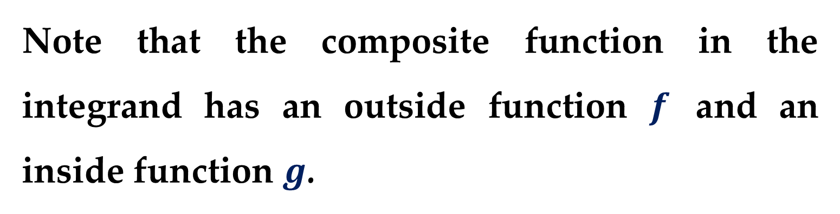
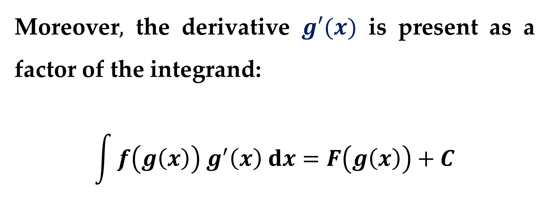
Note that the composite function in the integrand has an outside function $f$ and an inside function $g$.
Moreover$,$ the derivative $g′(x)$ is present as a factor of the integrand:
$$\int{f\left(g\left(x\right)\right) g^{′}\left(x\right) dx}=F\left(g\left(x\right)\right)+C$$
Outside function
Derivative of inside function
Inside function

Slide 11
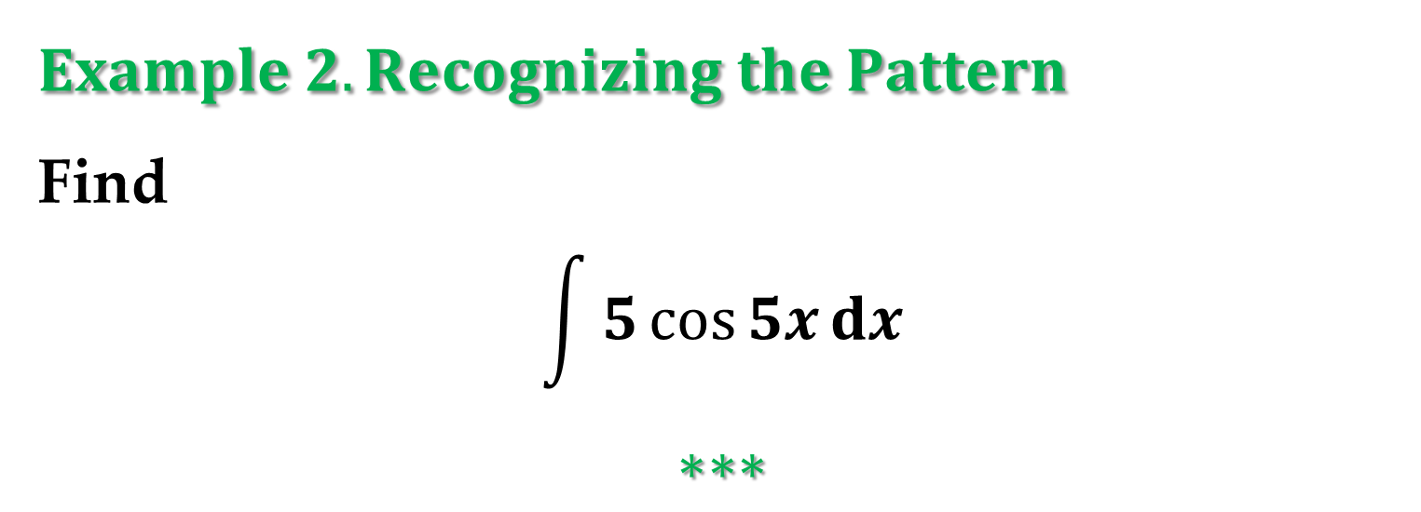
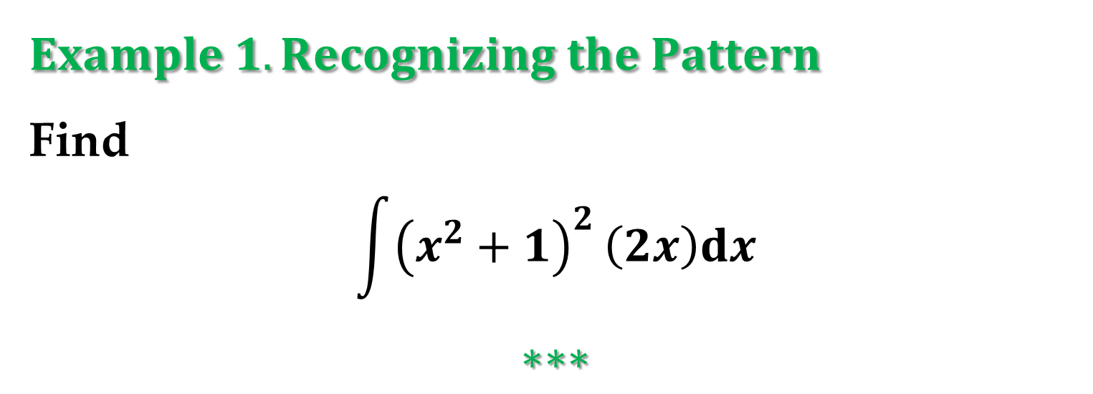
$$Example 1. Recognizing the Pattern$$
Find
$$\int{{\left(x^{2}+1\right)}^{2}}\left(2x\right)dx$$
$$∗∗∗$$
$$Example 2. Recognizing the Pattern$$
Find
$$\int{5\cos{5x}dx}$$
$$∗∗∗$$

Slide 12
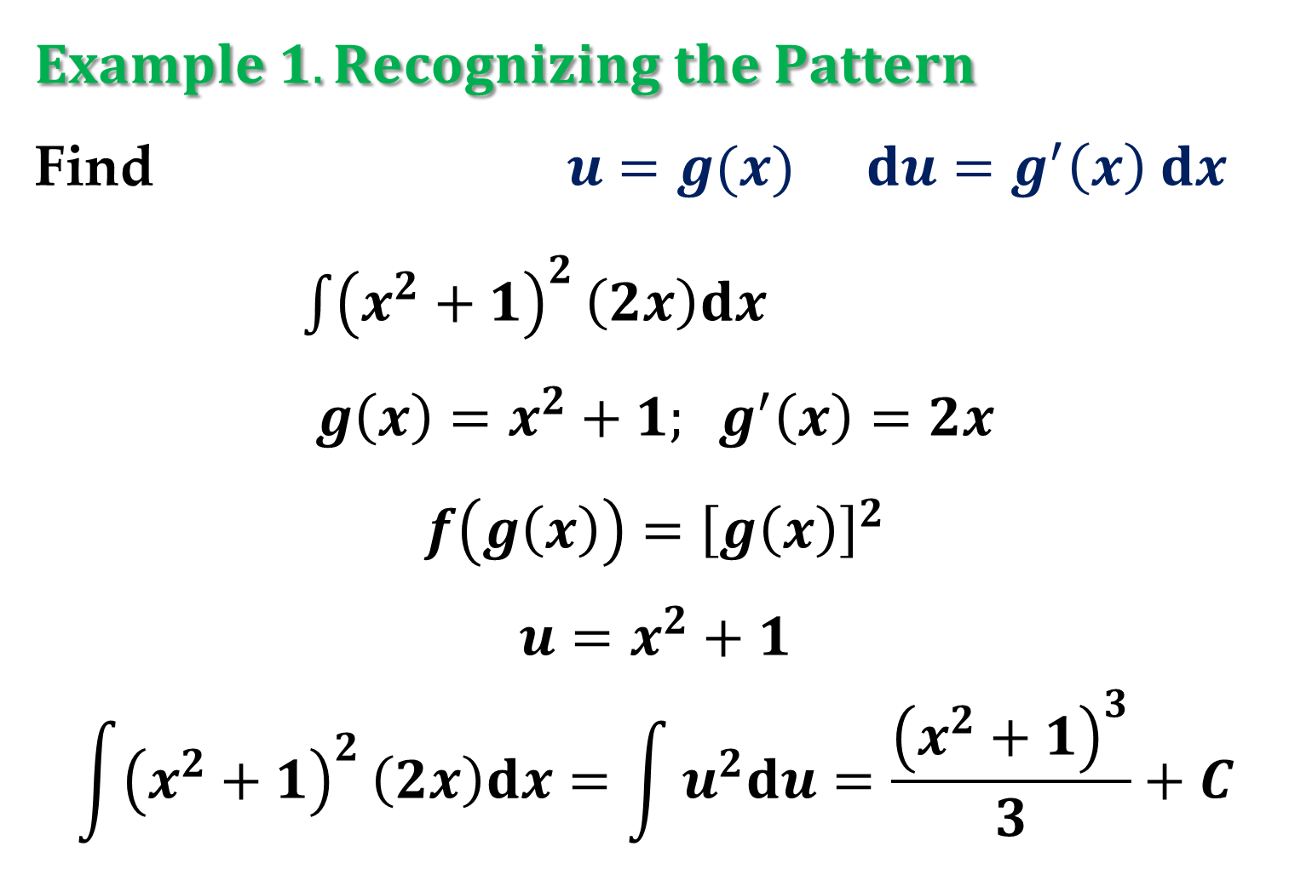
$$Example 1. Recognizing the Pattern$$
Find $u=g(x)$ $du=g^{′}\left(x\right) dx$
$\int{{\left(x^{2}+1\right)}^{2}}\left(2x\right)dx$
$$g\left(x\right)=x^{2}+1; g^{′}\left(x\right)=2x$$
$$f\left(g\left(x\right)\right)={\left[g\left(x\right)\right]}^{2}$$
$$u=x^{2}+1$$
$$\int{{\left(x^{2}+1\right)}^{2}}\left(2x\right)dx=\int{u^{2}du}=\frac{{\left(x^{2}+1\right)}^{3}}{3}+C$$

Slide 13
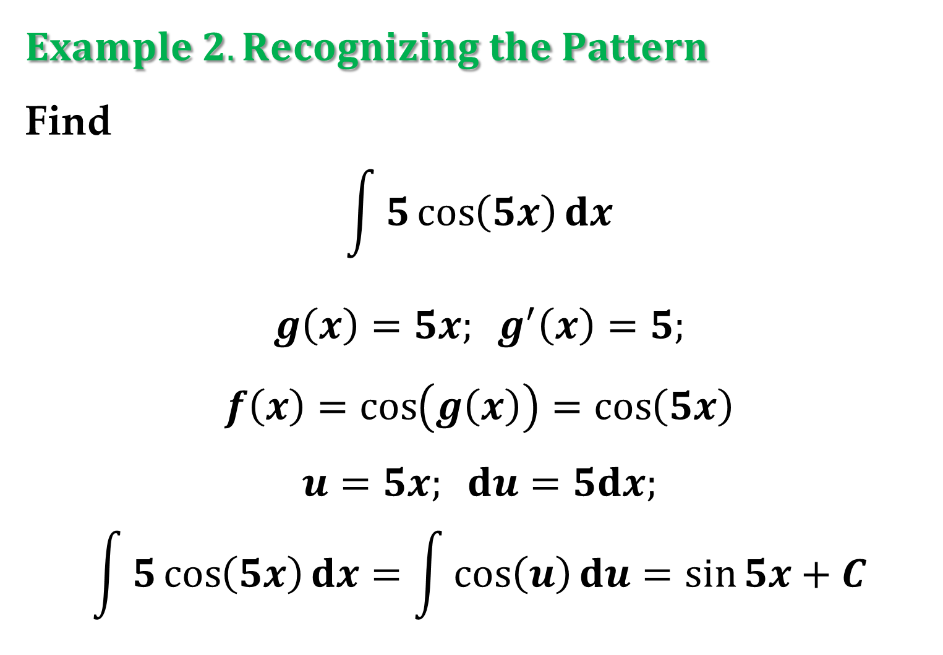
$$Example 2. Recognizing the Pattern$$
Find
$$\int{5\cos\left(5x\right)dx}$$
$$g\left(x\right)=5x; g^{′}\left(x\right)=5;$$
$$f\left(x\right)=\cos\left(g\left(x\right)\right)=\cos\left(5x\right)$$
$$u=5x; du=5dx;$$
$$\int{5\cos\left(5x\right)dx}=\int{\cos\left(u\right)du}=\sin{5x}+C$$

Slide 14
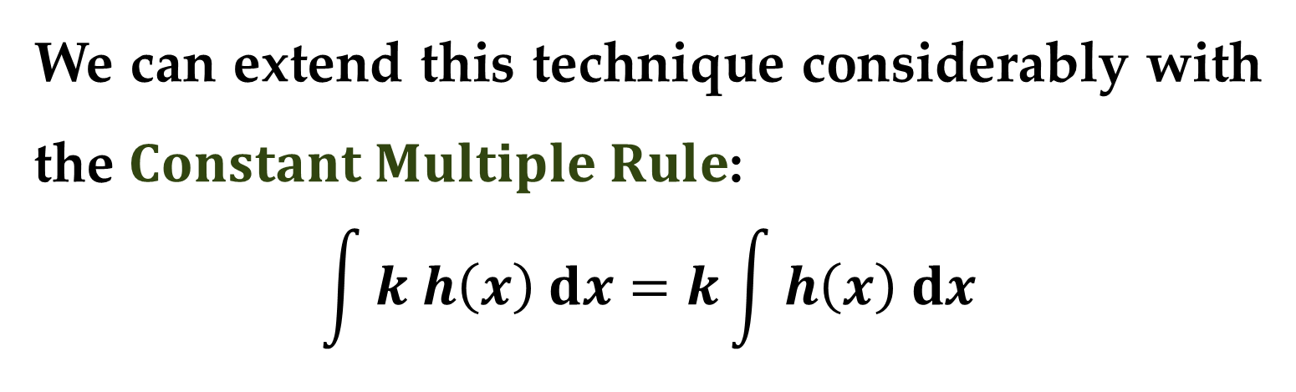
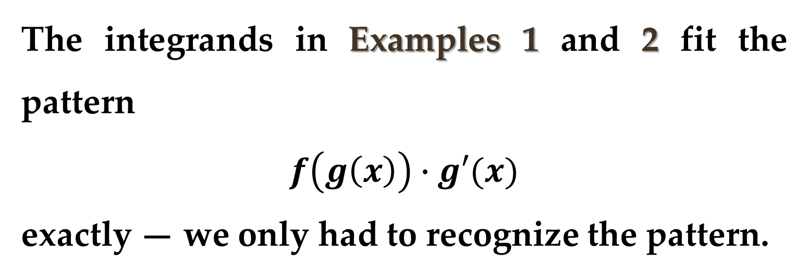
The integrands in Examples 1 and 2 fit the pattern
$$f\left(g\left(x\right)\right)∙g′(x)$$
exactly — we only had to recognize the pattern.
We can extend this technique considerably with the $Constant Multiple Rule$:
$$\int{k h\left(x\right) dx}=k\int{h\left(x\right) dx}$$

Slide 15
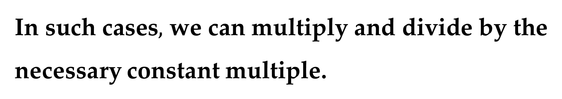
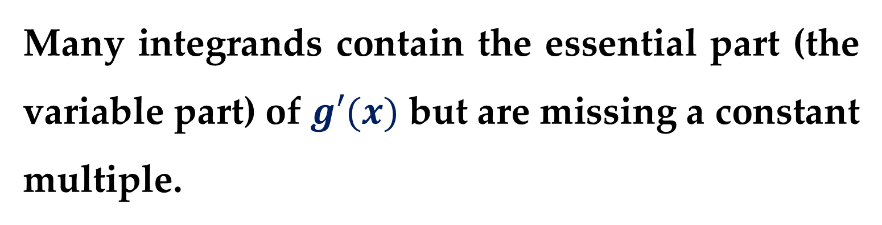
Many integrands contain the essential part (the variable part) of $g′(x)$ but are missing a constant multiple.
In such cases$,$ we can multiply and divide by the necessary constant multiple.

Slide 16
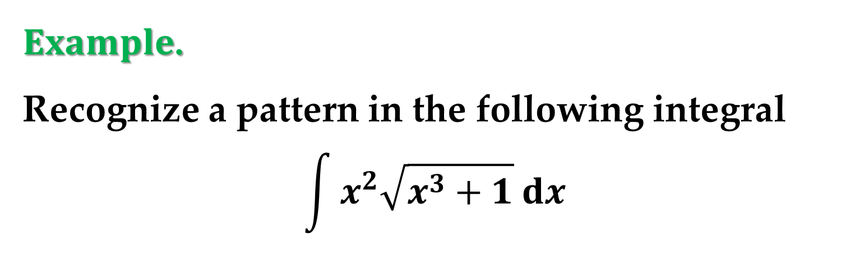
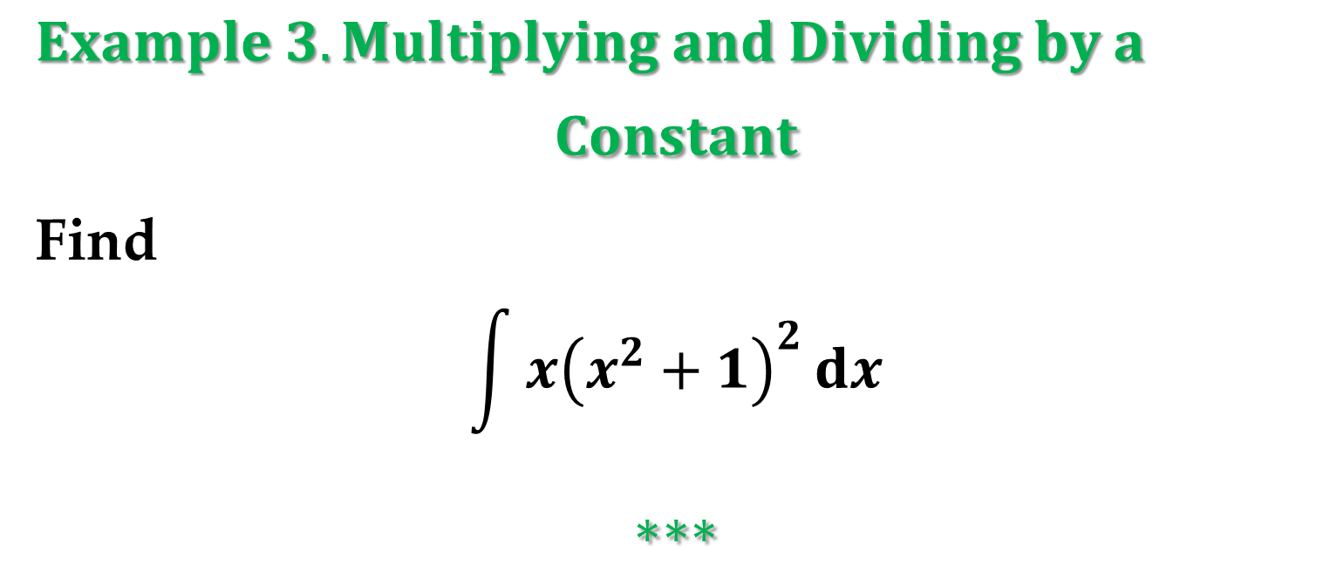
$Example 3. Multiplying and Dividing by a$
$$Constant$$
Find
$$\int{x{\left(x^{2}+1\right)}^{2}}dx$$
$$∗∗∗$$
$Example$.
Recognize a pattern in the following integral
$$\int{x^{2}\sqrt{x^{3}+1} dx}$$

Slide 17
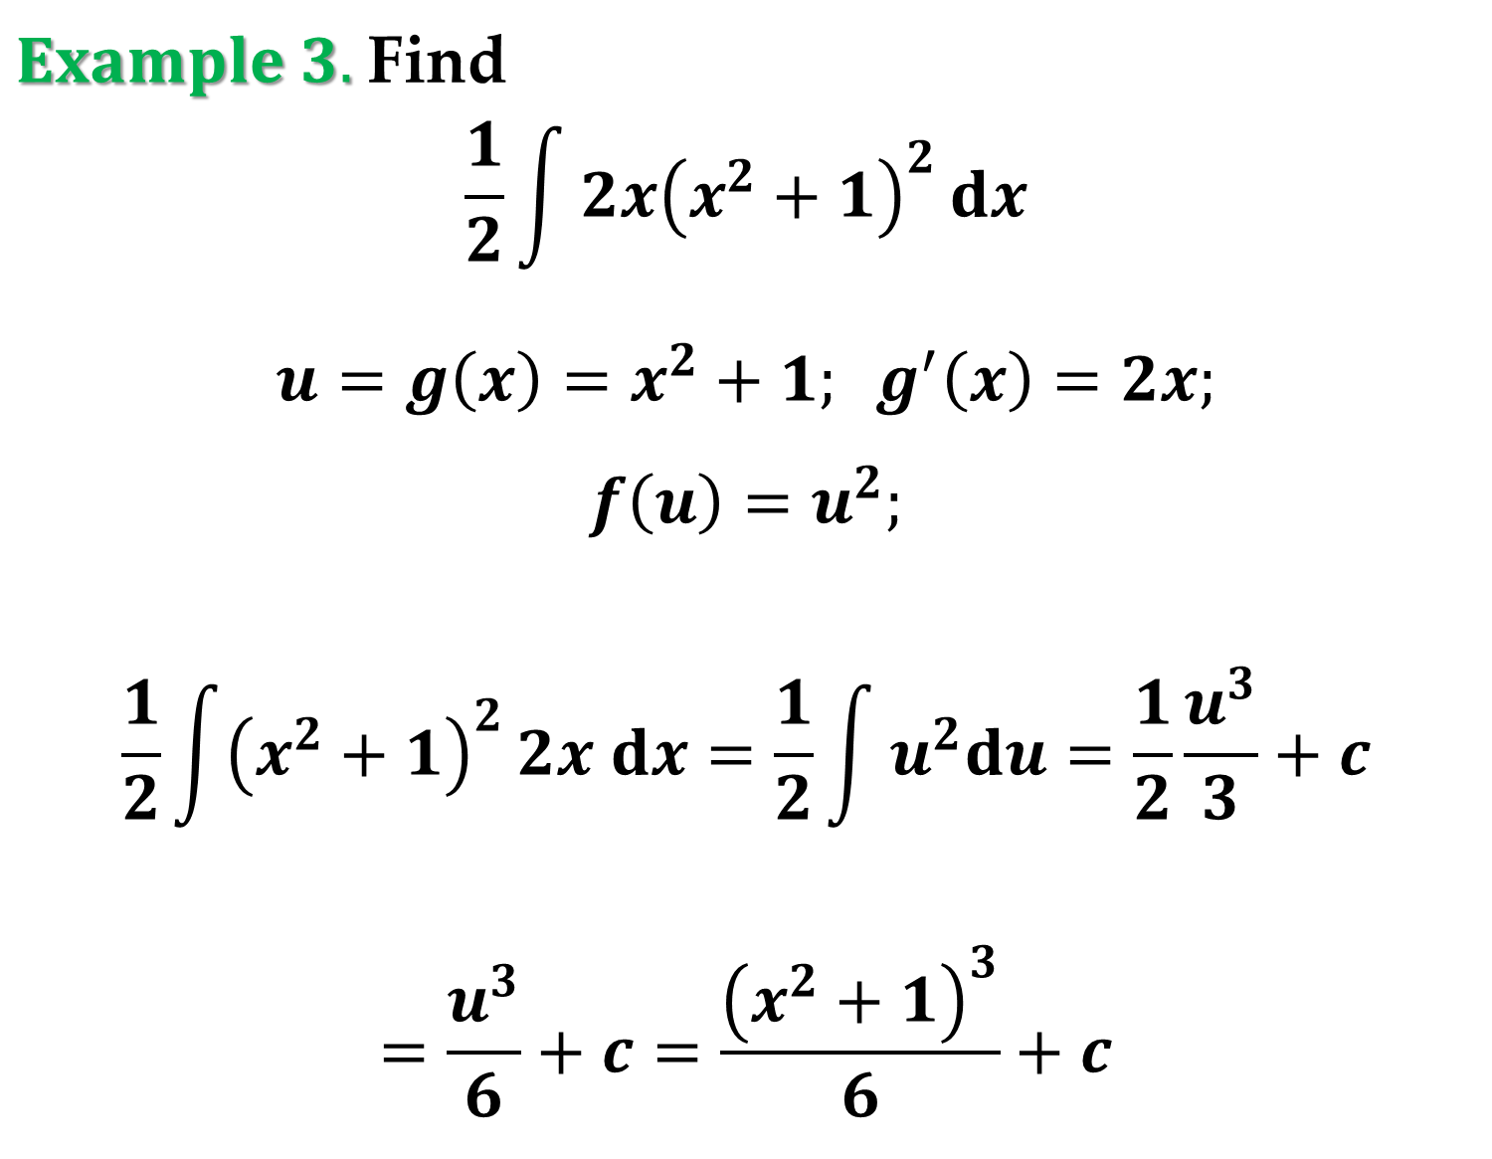
$Example 3.$Find
$$\frac{1}{2}\int{2x{\left(x^{2}+1\right)}^{2}}dx$$
$$u=g\left(x\right)=x^{2}+1; g^{′}\left(x\right)=2x;$$
$$f\left(u\right)=u^{2};$$
$$\frac{1}{2}\int{{\left(x^{2}+1\right)}^{2}}2x dx=\frac{1}{2}\int{u^{2}du}=\frac{1}{2}\frac{u^{3}}{3}+c$$
$$=\frac{u^{3}}{6}+c=\frac{{\left(x^{2}+1\right)}^{3}}{6}+c$$

Slide 18
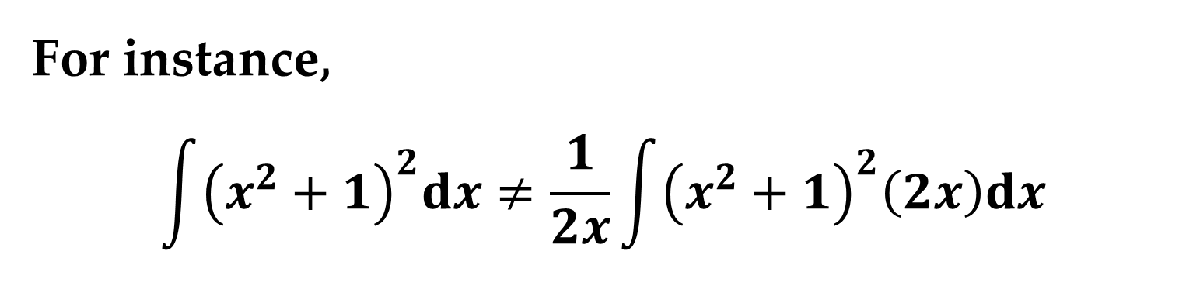
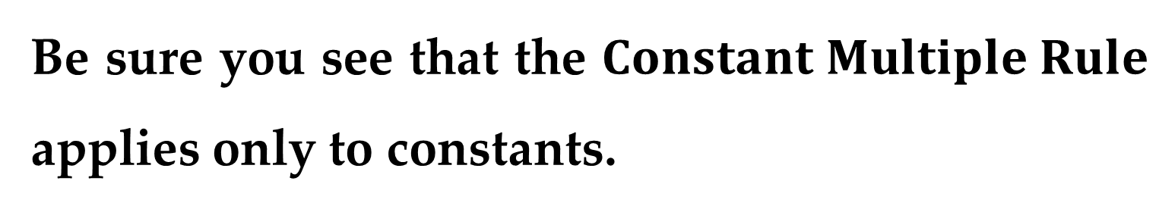
Be sure you see that the $Constant Multiple Rule$ applies only to constants.
You cannot multiply and divide by a variable and then move the variable outside the integral sign.
For instance,
$$\int{{\left(x^{2}+1\right)}^{2}dx}≠\frac{1}{2x}\int{{\left(x^{2}+1\right)}^{2}\left(2x\right)dx}$$

Slide 19
After all, if it were legitimate to move variable quantities outside the integral sign, we could move the entire integrand out and simplify the whole process.
But the result would be incorrect.

Slide 20
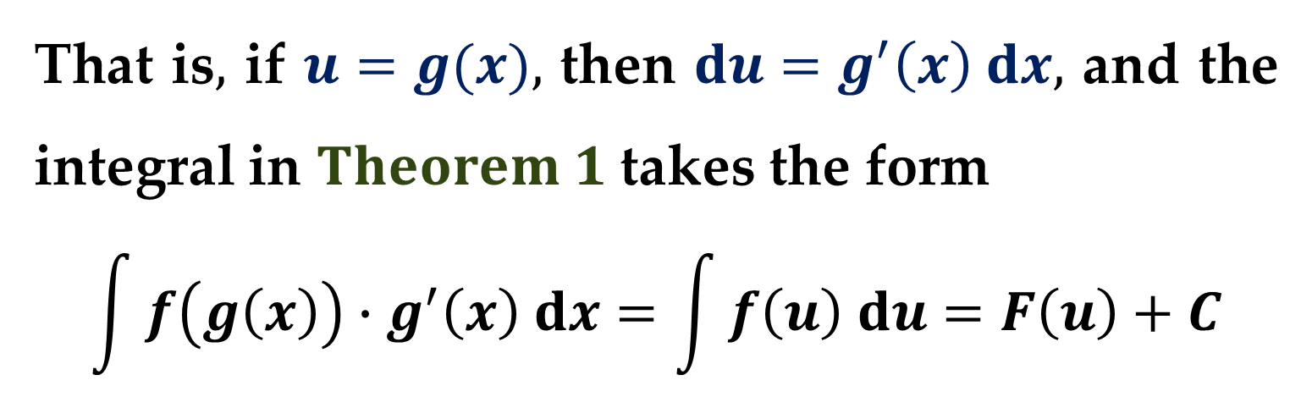
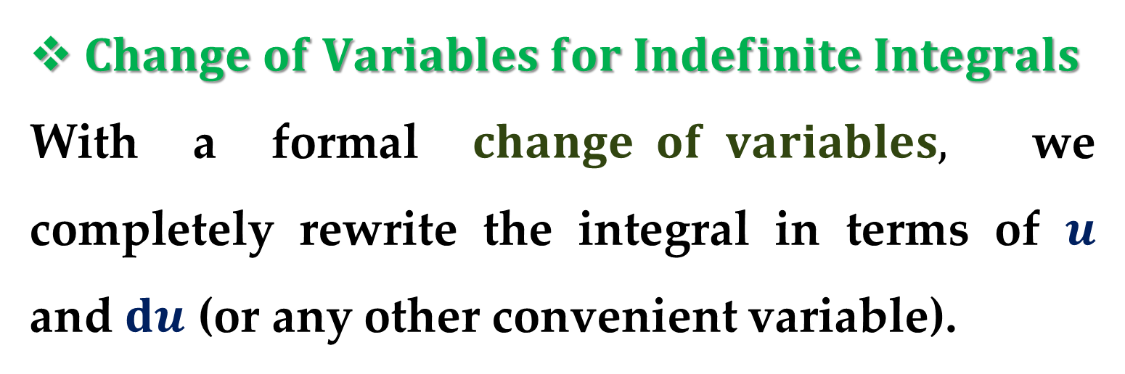
$Change of Variables for Indefinite Integrals$
With a formal $change of variables,$ we completely rewrite the integral in terms of $u$ and $du$ (or any other convenient variable).
That is$,$ if $u=g(x),$ then $du=g^{′}\left(x\right) dx,$ and the integral in $Theorem 1$ takes the form
$$\int{f\left(g\left(x\right)\right)∙g^{′}\left(x\right) dx}=\int{f\left(u\right) du}=F\left(u\right)+C$$

Slide 21
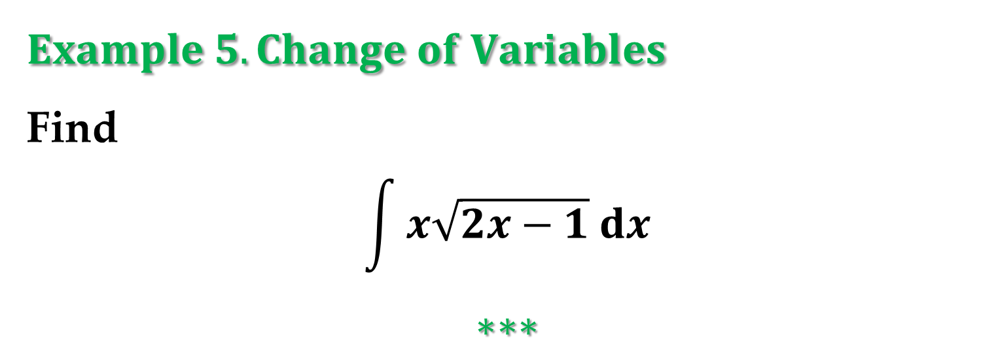

$$Example 4. Change of Variables$$
Find
$$\int{\sqrt{2x−1} dx}$$
$$∗∗∗$$
$$Example 5. Change of Variables$$
Find
$$\int{x\sqrt{2x−1} dx}$$
$$∗∗∗$$

Slide 22
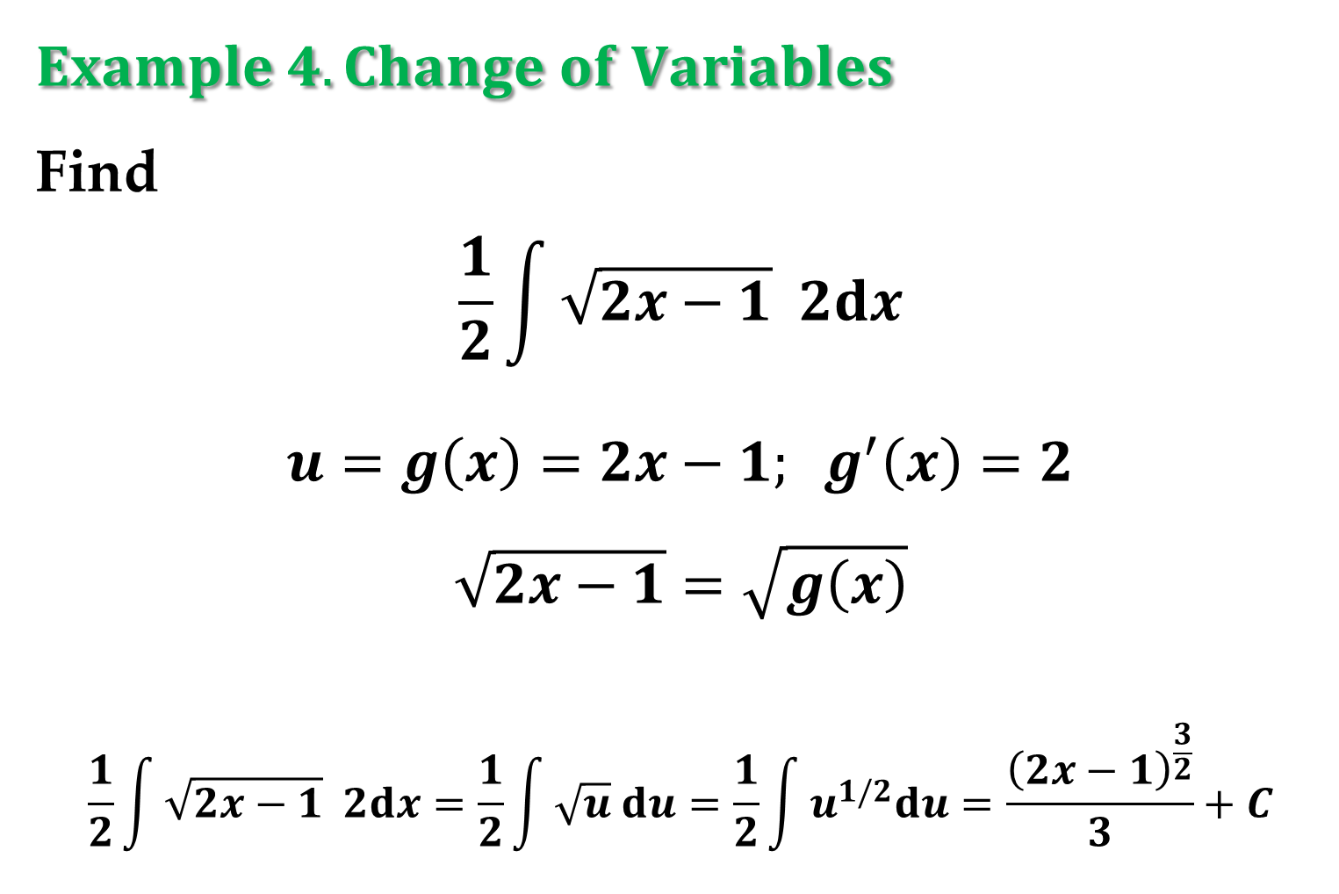
$$Example 4. Change of Variables$$
Find
$$\frac{1}{2}\int{\sqrt{2x−1} 2dx}$$
$$u=g\left(x\right)=2x−1; g^{′}\left(x\right)=2$$
$$\sqrt{2x−1}=\sqrt{g\left(x\right)}$$
$$\frac{1}{2}\int{\sqrt{2x−1} 2dx}=\frac{1}{2}\int{\sqrt{u} du}=\frac{1}{2}\int{u^{1/2}du}=\frac{{\left(2x−1\right)}^{\frac{3}{2}}}{3}+C$$

Slide 23
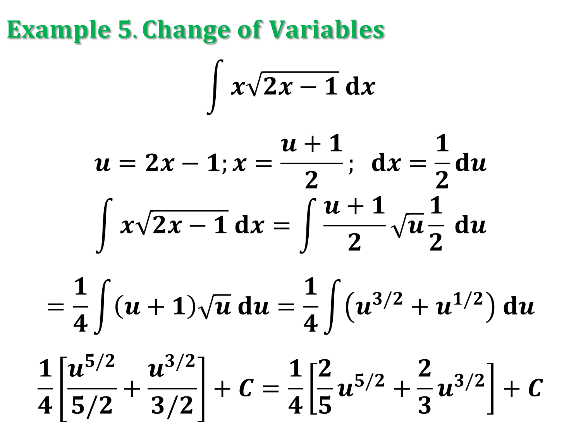
$$Example 5. Change of Variables$$
$$\int{x\sqrt{2x−1} dx}$$
$$u=2x−1;x=\frac{u+1}{2}; dx=\frac{1}{2}du$$
$$\int{x\sqrt{2x−1} dx}=\int{\frac{u+1}{2}\sqrt{u}\frac{1}{2} du}$$
$$=\frac{1}{4}\int{\left(u+1\right)\sqrt{u} du}=\frac{1}{4}\int{\left(u^{3/2}+u^{1/2}\right) du}$$
$$\frac{1}{4}\left[\frac{u^{5/2}}{5/2}+\frac{u^{3/2}}{3/2}\right]+C=\frac{1}{4}\left[\frac{2}{5}u^{5/2}+\frac{2}{3}u^{3/2}\right]+C$$

Slide 24
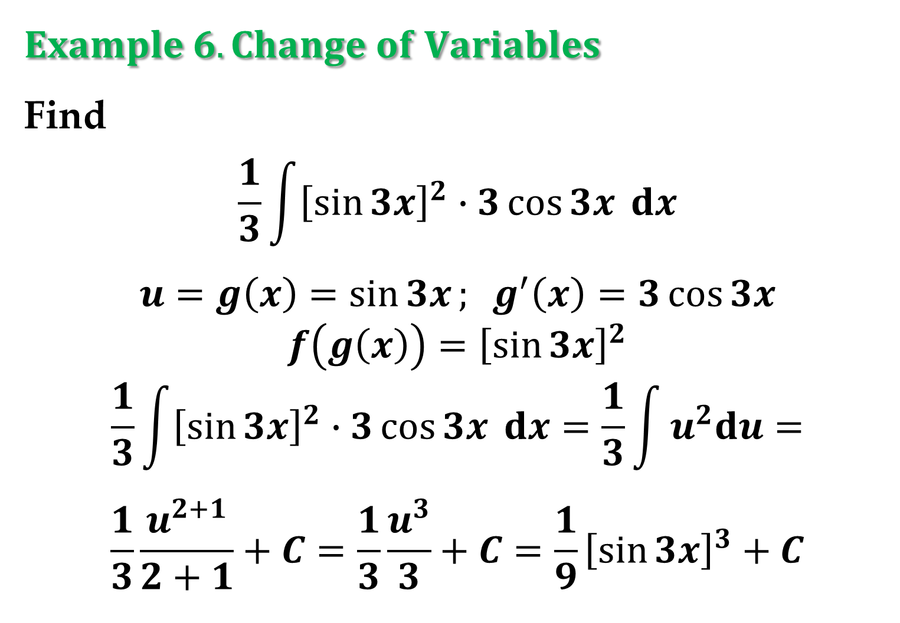
$$Example 6. Change of Variables$$
Find
$$\frac{1}{3}\int{{\left[\sin{3x}\right]}^{2}∙3\cos{3x} dx}$$
$$u=g\left(x\right)=\sin{3x}; g^{′}\left(x\right)=3\cos{3x}$$
$$f\left(g\left(x\right)\right)={\left[\sin{3x}\right]}^{2}$$
$$\frac{1}{3}\int{{\left[\sin{3x}\right]}^{2}∙3\cos{3x} dx}=\frac{1}{3}\int{u^{2}du}=$$
$$\frac{1}{3}\frac{u^{2+1}}{2+1}+C=\frac{1}{3}\frac{u^{3}}{3}+C=\frac{1}{9}{\left[\sin{3x}\right]}^{3}+C$$

Slide 25
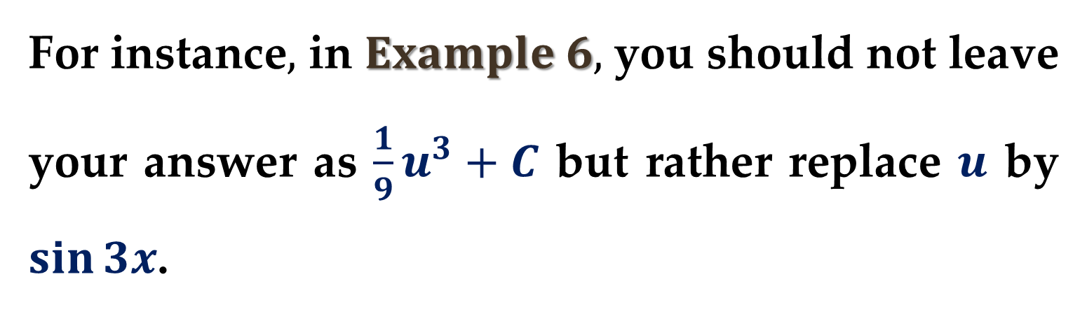
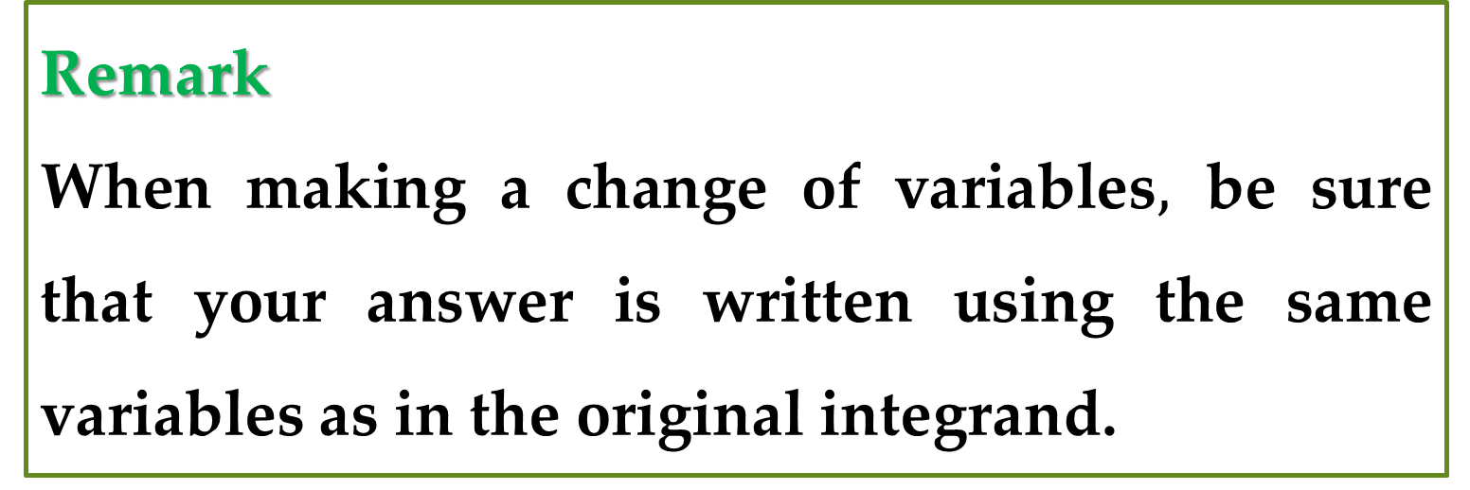
Remark
When making a change of variables$,$ be sure that your answer is written using the same variables as in the original integrand.
For instance$,$ in $Example 6,$ you should not leave your answer as $\frac{1}{9}u^{3}+C$ but rather replace $u$ by $\sin{3x}$.

Slide 26
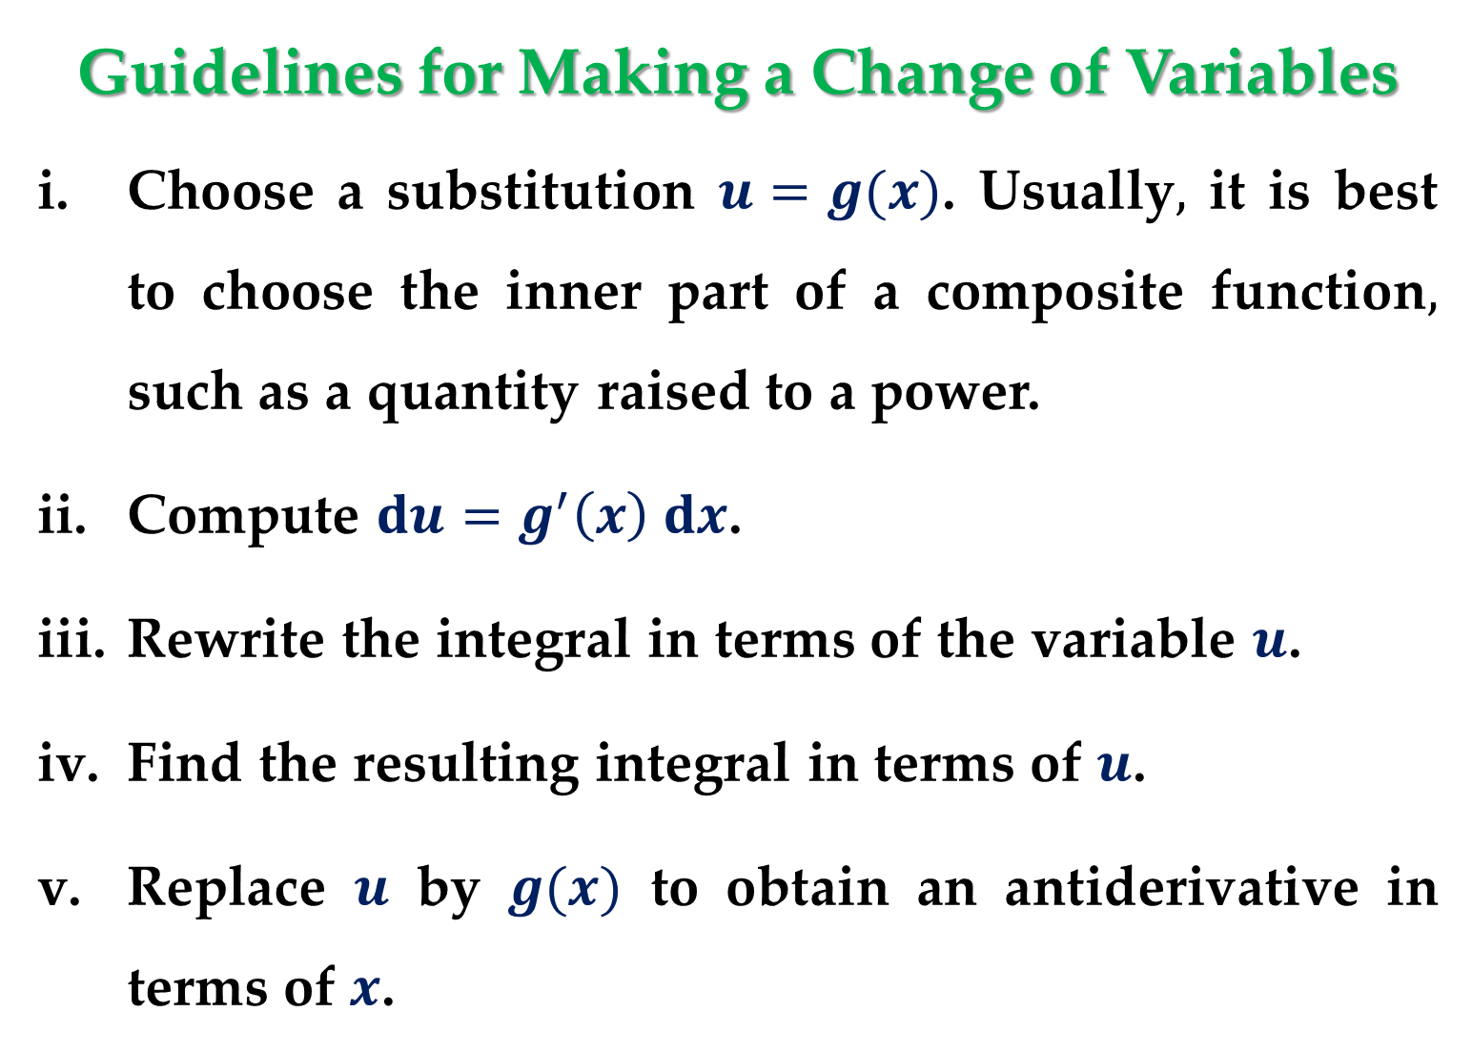
Guidelines for Making a Change of Variables
Choose a substitution $u=g(x)$. Usually$,$ it is best to choose the inner part of a composite function$,$ such as a quantity raised to a power.
Compute $du=g^{′}\left(x\right) dx$.
Rewrite the integral in terms of the variable $u$.
Find the resulting integral in terms of $u$.
Replace $u$ by $g(x)$ to obtain an antiderivative in terms of $x$.

Slide 27
So far, we have seen two techniques for applying substitution, and we will see more techniques in the remainder of this lecture.
Each technique differs slightly from the others.
We should remember, however, that the goal is the same with each technique — we are trying to find an antiderivative of the integrand.

Slide 28
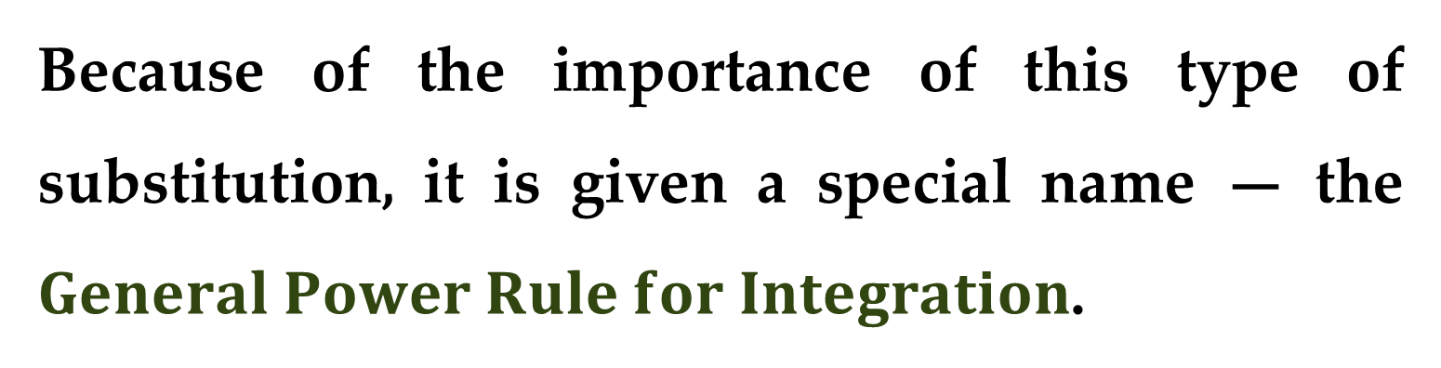
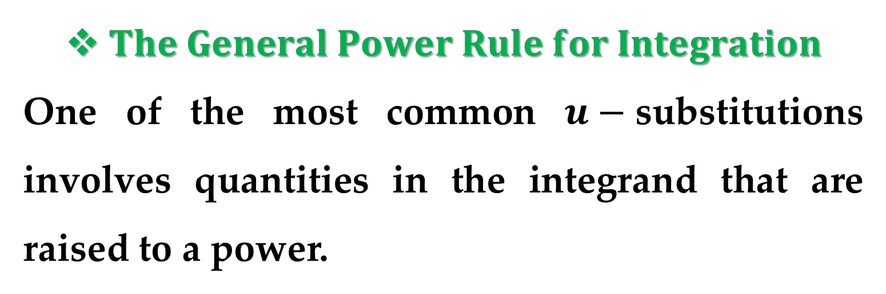
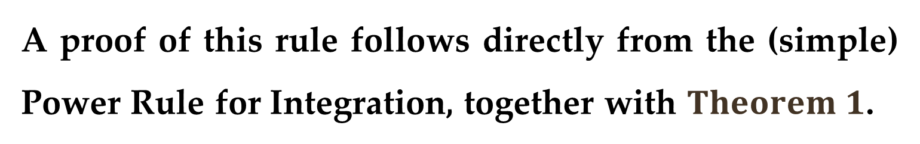
$The General Power Rule for Integration$
One of the most common $u−$substitutions involves quantities in the integrand that are raised to a power.
Because of the importance of this type of substitution, it is given a special name — the $General Power Rule for Integration$.
A proof of this rule follows directly from the (simple) Power Rule for Integration, together with $Theorem 1$.

Slide 29
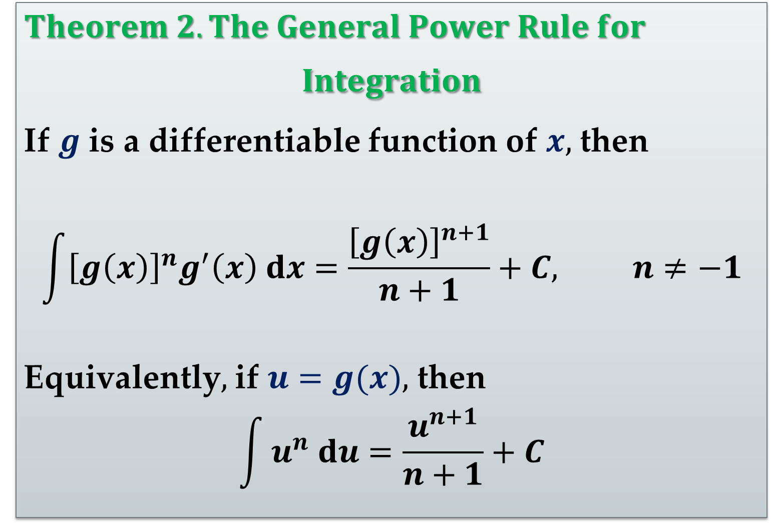
$Theorem 2. The General Power Rule for$
$$Integration$$
If $g$ is a differentiable function of $x,$ then
$$\int{{\left[g\left(x\right)\right]}^{n}g^{′}\left(x\right) dx}=\frac{{\left[g\left(x\right)\right]}^{n+1}}{n+1}+C, n≠−1$$
Equivalently$,$ if $u=g(x),$ then
$$\int{u^{n} du}=\frac{u^{n+1}}{n+1}+C$$

Slide 30
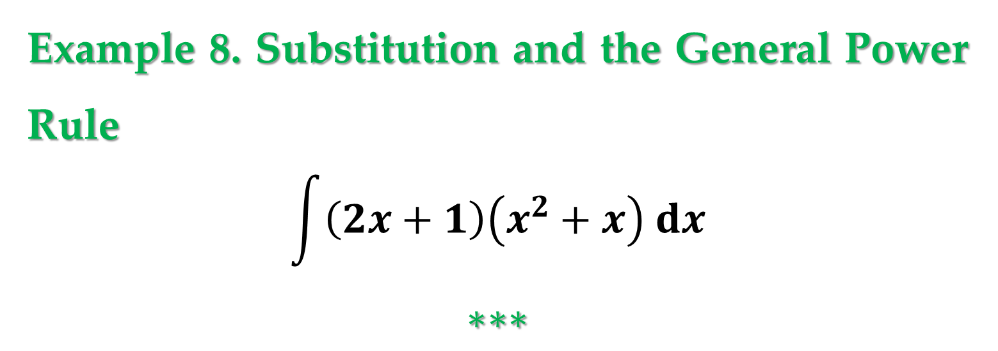
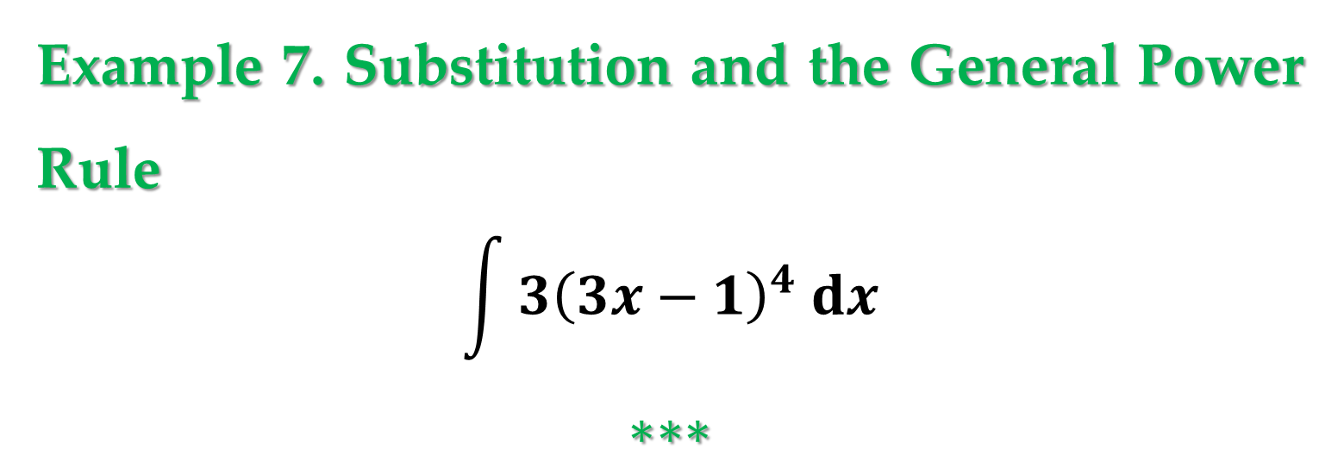
Example 7. Substitution and the General Power Rule
$$\int{3{\left(3x−1\right)}^{4} dx}$$
$$∗∗∗$$
Example 8. Substitution and the General Power Rule
$$\int{\left(2x+1\right)\left(x^{2}+x\right) dx}$$
$$∗∗∗$$

Slide 31
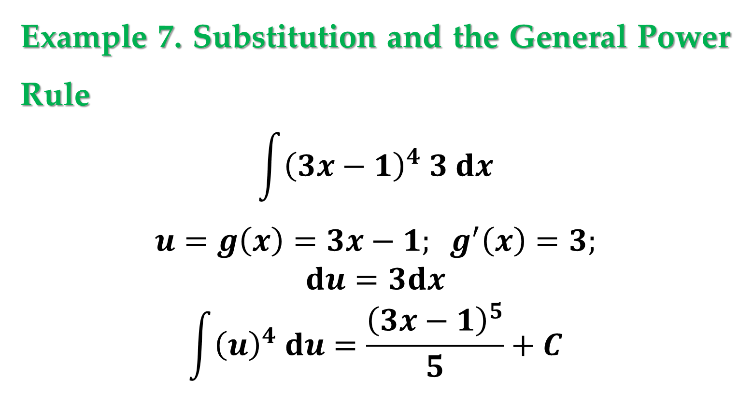
Example 7. Substitution and the General Power Rule
$$\int{{\left(3x−1\right)}^{4} 3 dx}$$
$$u=g\left(x\right)=3x−1; g^{′}\left(x\right)=3;$$
$$du=3dx$$
$$\int{{\left(u\right)}^{4} du}=\frac{{\left(3x−1\right)}^{5}}{5}+C$$

Slide 32
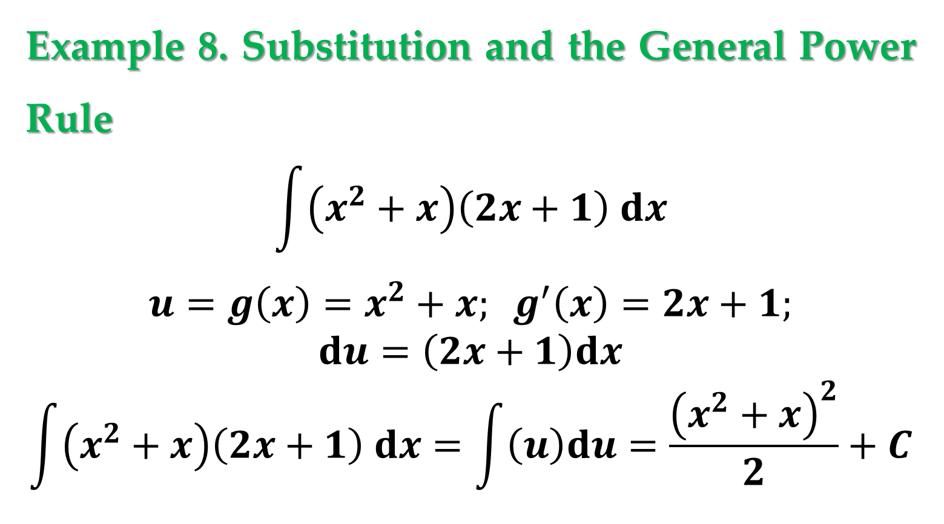
Example 8. Substitution and the General Power Rule
$$\int{\left(x^{2}+x\right)\left(2x+1\right) dx}$$
$$u=g\left(x\right)=x^{2}+x; g^{′}\left(x\right)=2x+1;$$
$$du=\left(2x+1\right)dx$$
$$\int{\left(x^{2}+x\right)\left(2x+1\right) dx}=\int{\left(u\right)du}=\frac{{\left(x^{2}+x\right)}^{2}}{2}+C$$

Slide 33
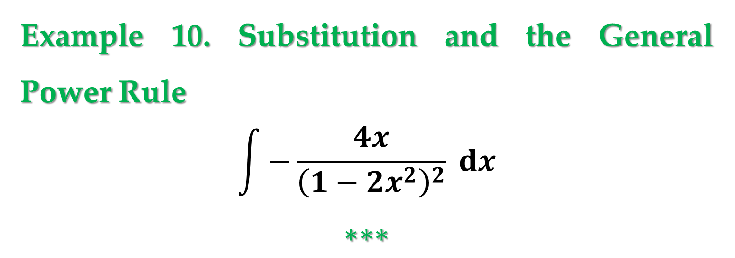

Example 9. Substitution and the General Power Rule
$$\int{3x^{2}\sqrt{x^{3}−2} dx}$$
$$∗∗∗$$
Example 10. Substitution and the General Power Rule
$$\int{−\frac{4x}{{\left(1−2x^{2}\right)}^{2}} dx}$$
$$∗∗∗$$

Slide 34
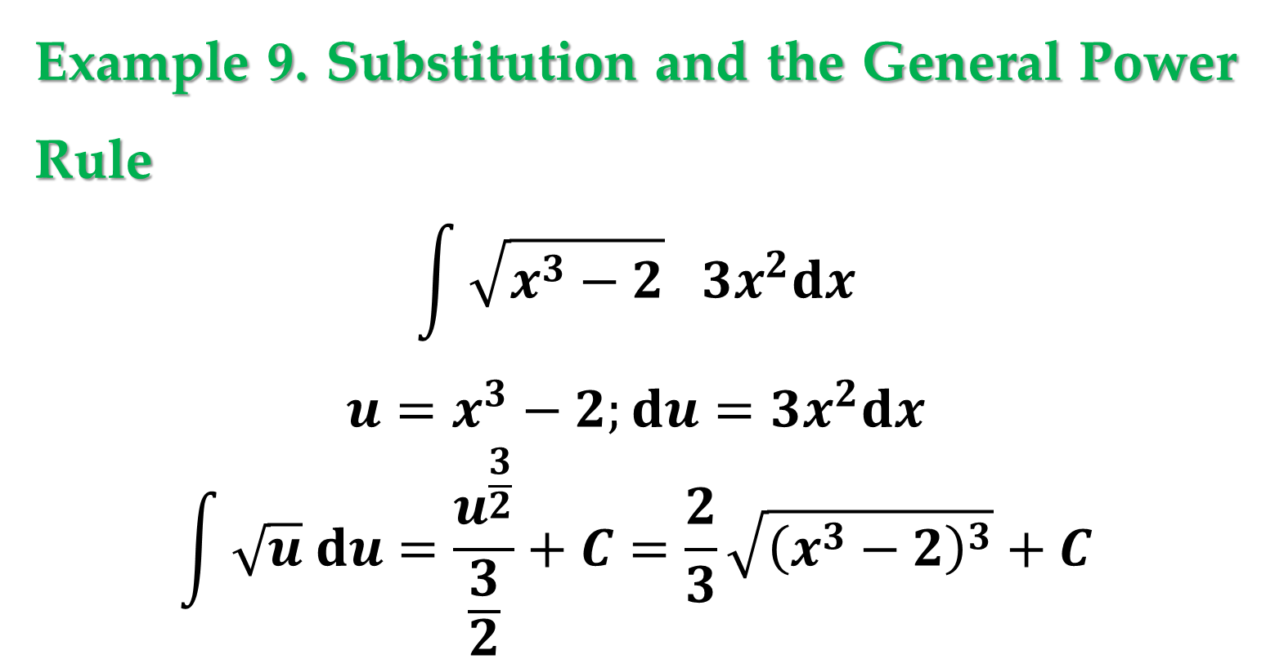
Example 9. Substitution and the General Power Rule
$$\int{\sqrt{x^{3}−2} 3x^{2}dx}$$
$$u=x^{3}−2;du=3x^{2}dx$$
$$\int{\sqrt{u} du}=\frac{u^{\frac{3}{2}}}{\frac{3}{2}}+C=\frac{2}{3}\sqrt{{\left(x^{3}−2\right)}^{3}}+C$$

Slide 35
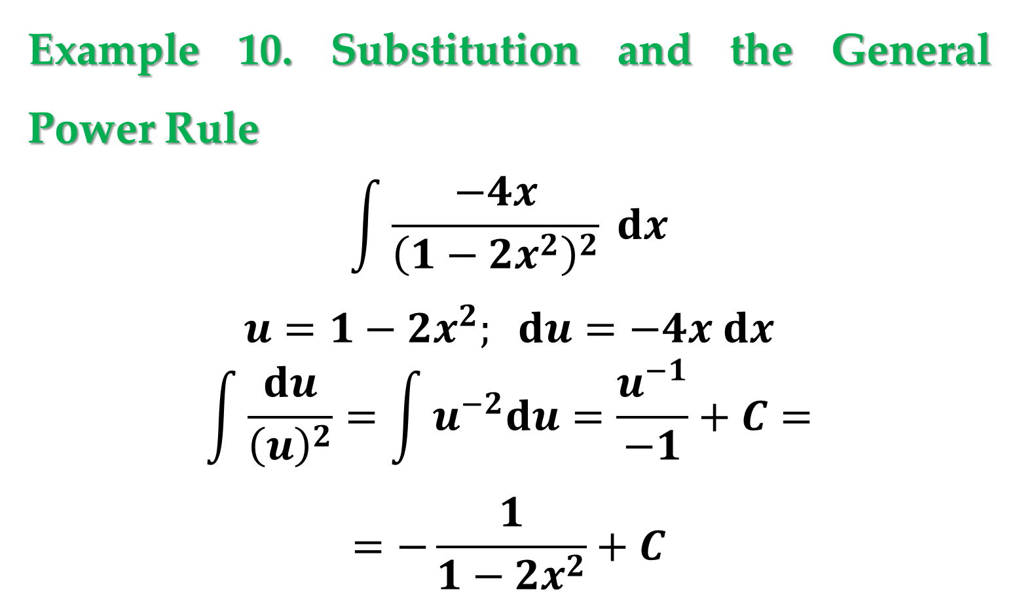
Example 10. Substitution and the General Power Rule
$$\int{\frac{−4x}{{\left(1−2x^{2}\right)}^{2}} dx}$$
$$u=1−2x^{2}; du=−4x dx$$
$$\int{\frac{du}{{\left(u\right)}^{2}}}=\int{u^{−2}du}=\frac{u^{−1}}{−1}+C=$$
$$=−\frac{1}{1−2x^{2}}+C$$

Slide 36
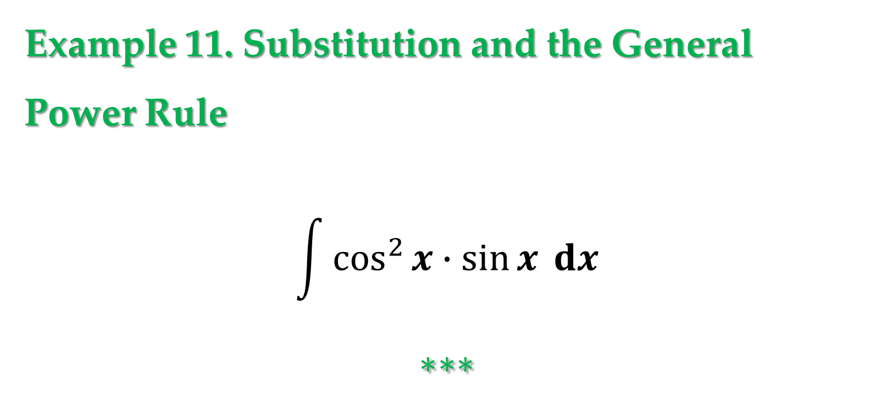
Example 11. Substitution and the General
Power Rule
$$\int{\cos^{2}{x}∙\sin{x} dx}$$
$$∗∗∗$$

Slide 37
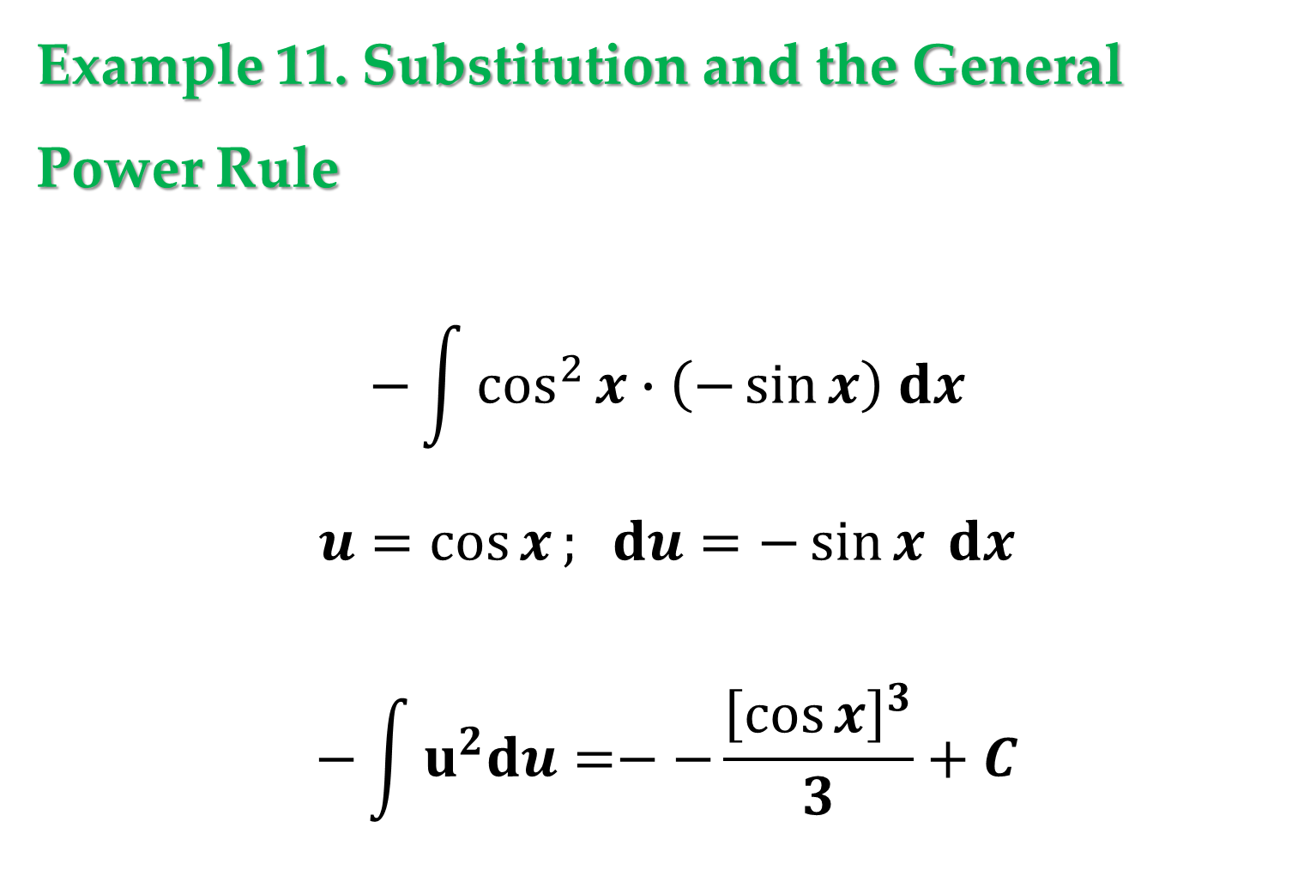
Example 11. Substitution and the General
Power Rule
$$−\int{\cos^{2}{x}∙\left(−\sin{x}\right) dx}$$
$$u=\cos{x}; du=−\sin{x} dx$$
$$−\int{u^{2}du}=−−\frac{{\left[\cos{x}\right]}^{3}}{3}+C$$

Slide 38
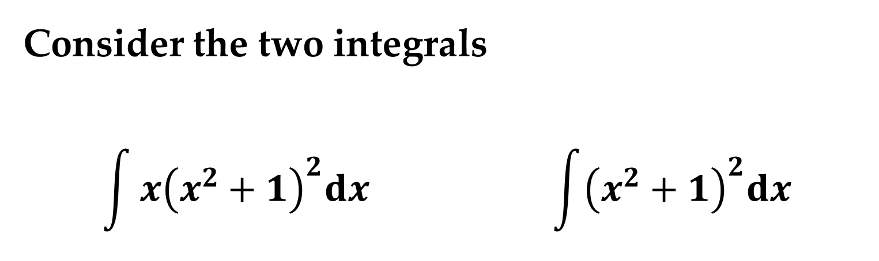
Remark
Some integrals whose integrands involve quantities raised to powers cannot be found by the General Power Rule.
Consider the two integrals
$$\int{x{\left(x^{2}+1\right)}^{2}dx} \int{{\left(x^{2}+1\right)}^{2}dx}$$

Slide 39
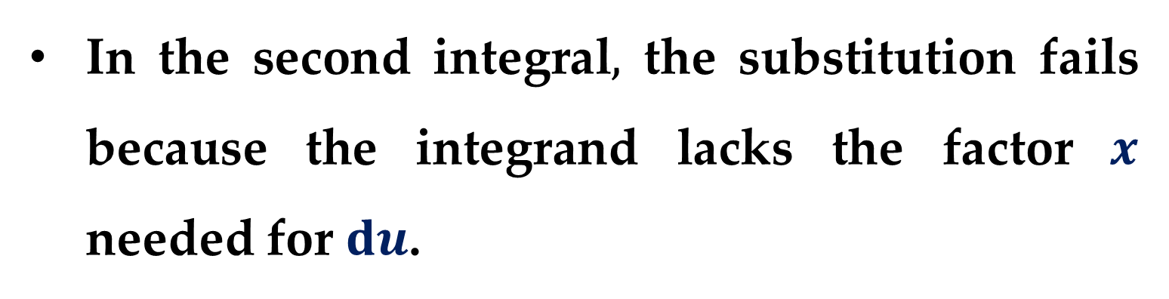
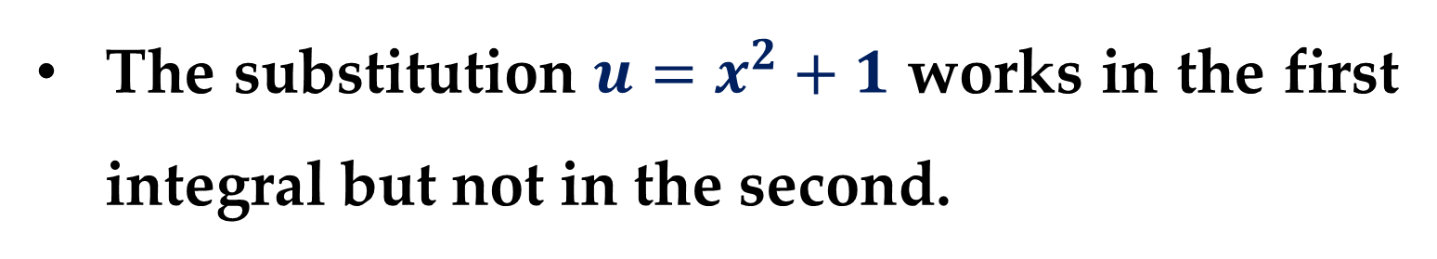
The substitution $u=x^{2}+1$ works in the first integral but not in the second.
In the second integral$,$ the substitution fails because the integrand lacks the factor $x$ needed for $du$.

Slide 40
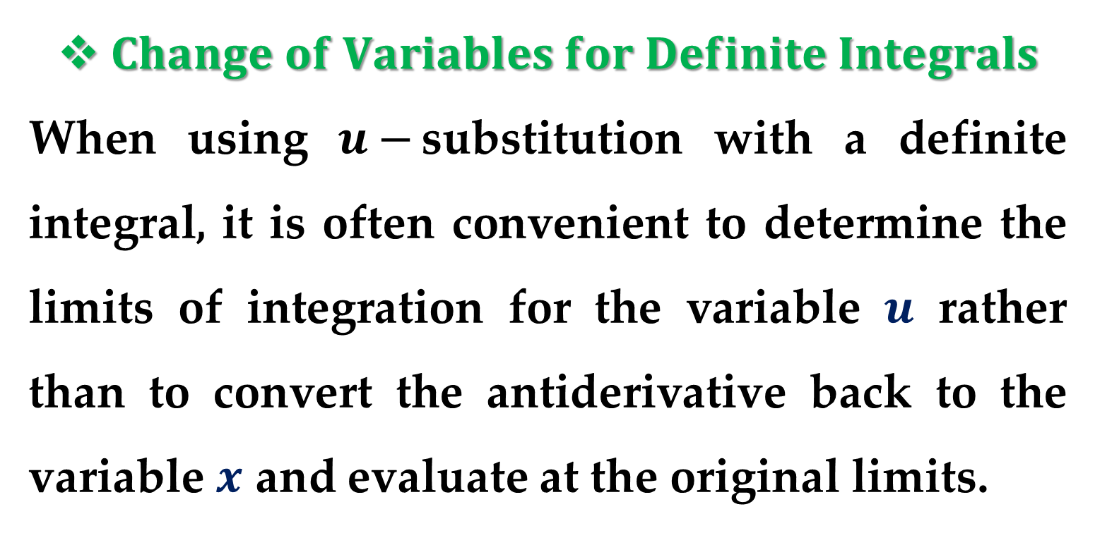
$Change of Variables for Definite Integrals$
When using $u−$substitution with a definite integral, it is often convenient to determine the limits of integration for the variable $u$ rather than to convert the antiderivative back to the variable $x$ and evaluate at the original limits.
This change of variables is stated explicitly in the next theorem.

Slide 41

$Theorem 3. Change of Variables for Definite$
$$Integrals$$
If the function $u=g(x)$ has a continuous derivative on the closed interval $[a,b]$ and $f$ is continuous on the range of $g,$ then
$$\int_{a}^{b}{f\left(g\left(x\right)\right)g^{′}\left(x\right) dx}=\int_{g(a)}^{g(b)}{f\left(u\right) du}$$

Slide 42



The proof follows from $Theorem 1$ combined with the $Fundamental Theorem of Calculus$.
Remark
When evaluating definite integrals by substitution$,$ it is possible for the upper limit of integration of the $u−$variable form to be smaller than the lower limit.
If this happens$,$ do not rearrange the limits. Simply evaluate as usual.

Slide 43


For example$,$ after substituting $u=\sqrt{1−x}$ in the integral
$$\int_{0}^{1}{x^{2}\sqrt{1−x} dx}$$
you obtain $u=\sqrt{1−1}=0$ when $x=1,$ and $u=\sqrt{1−0}=1$ when $x=0$.
So the correct $u−$variable form of this integral:
$$−2\int_{1}^{0}{{\left(1−u^{2}\right)}^{2}u^{2} du}$$

Slide 44


Example 12. Change of Variables
Evaluate
$$\int_{0}^{1}{x{\left(x^{2}+1\right)}^{3}dx}$$
$$∗∗∗$$
Example 13. Change of Variables
Evaluate
$$\int_{1}^{2}{\frac{x}{\sqrt{2x−1}}dx}$$
$$∗∗∗$$

Slide 45

Example 12. Change of Variables
Evaluate
$$\frac{1}{2}\int_{0}^{1}{{\left(x^{2}+1\right)}^{3}2x dx}$$
$$u=x^{2}+1;du=2x dx$$
$$u_{low}=0^{2}+1=1; u_{upp}=1^{2}+1=2$$
$$\frac{1}{2}\int_{1}^{2}{u^{3}du}=\frac{u^{4}}{8}{\left.​\right|}_{1}^{2}=\frac{1}{8}\left[2^{4}−1^{4}\right]=\frac{15}{8}$$

Slide 46

Example 13. Change of Variables
Evaluate
$$\int_{1}^{2}{\frac{x}{\sqrt{2x−1}}dx}$$
$$u=2x−1; du=2dx; x=\frac{u+1}{2}$$
$$\int_{1}^{2}{\frac{x}{\sqrt{2x−1}}dx}=\frac{1}{4}\int_{1}^{3}{\frac{u+1}{\sqrt{u}}du}=$$
$$\frac{1}{4}\int_{1}^{3}{\left[u^{1/2}+u^{−1/2}\right]du}=\frac{1}{4}\left[\frac{\sqrt{u^{3}}}{3/2}+\frac{\sqrt{u}}{1/2}\right]{\left.​\right|}_{1}^{3}$$

Slide 47

Example 13. Change of Variables
$$\frac{1}{4}\left[\frac{\sqrt{u^{3}}}{3/2}+\frac{\sqrt{u}}{1/2}\right]{\left.​\right|}_{1}^{3}=\frac{1}{2}\left[\frac{\sqrt{u^{3}}}{3}+\sqrt{u}\right]{\left.​\right|}_{1}^{3}=$$
$$=\frac{1}{2}\left\{\left[\sqrt{3}+\sqrt{3}\right]−\left[\frac{1}{3}+1\right]\right\}$$

Slide 48


Geometrically, you can interpret the equation
$$\int_{1}^{2}{\frac{x}{\sqrt{2x−1}}dx}=\int_{1}^{3}{\frac{u^{2}+1}{2}du}$$
to mean that the two different regions shown in $Figures 1$ and
$2$ have the
same area.

Slide 49


$Integration of Even and Odd Functions$
Even with a change of variables$,$ integration can be difficult.
Occasionally$,$ we can simplify the evaluation of a definite integral over an interval that is symmetric about the $y−$axis or about the origin by recognizing the integrand to be an even or odd function.

Slide 50


$Theorem 4. Integration of Even and Odd$
$$Functions$$
Let $f$ be integrable on the closed interval $[−a,a]$.
$(1)$ If $f$ is an even function$,$
then
$$\int_{−a}^{a}{f\left(x\right)dx}=2\int_{0}^{a}{f\left(x\right)dx}$$

Slide 51


$Theorem 4. Integration of Even and Odd$
$$Functions (continued)$$
$(2)$ If $f$ is an odd function$,$ then
$$\int_{−a}^{a}{f\left(x\right) dx}=0$$

Slide 52



$Proof$. Let’s prove the first property of the Theorem.
Because $f$ is even, we know that $f\left(x\right)=f\left(−x\right)$.
Using $Theorem 1$ with the substitution $u=−x$ produces
$$\int_{−a}^{0}{f\left(x\right)dx}=\int_{a}^{0}{f\left(−u\right)d\left(−u\right)}=−\int_{a}^{0}{f\left(u\right)du}$$

Slide 53


$Proof$.
$$…=\int_{0}^{a}{f\left(u\right)du}\underset{→}{\text{yields}}\int_{0}^{a}{f\left(x\right)dx}$$
Finally, using one of the properties of definite integrals, we obtain
$$\int_{−a}^{a}{f\left(x\right)dx}=\int_{−a}^{0}{f\left(x\right)dx}+\int_{0}^{a}{f\left(x\right)dx}=$$
$$=\int_{0}^{a}{f\left(x\right)dx}+\int_{0}^{a}{f\left(x\right)dx}=2\int_{0}^{a}{f\left(x\right)dx}$$

Slide 54


$Assignment$. The proof of the second property of the $Theorem$ is left to you as an exercise.
Example 14. Integration of an Odd Function
Evaluate
$$\int_{−\frac{π}{2}}^{\frac{π}{2}}{\left(\sin^{3}{x∙\cos{x}+\sin{x}∙\cos{x}}\right) dx}=0$$
$$∗∗∗$$

Slide 55



From $Figure 4$, we can see that the two regions on either side of the $y−$axis have the same area.
However, because one lies below the $x−$axis and one lies above it, integration produces a cancellation effect.

Slide 56
Thank you for attention

Slide 57
text
text
text

